Slide 1
Data Types in PostgreSQL

Slide 2
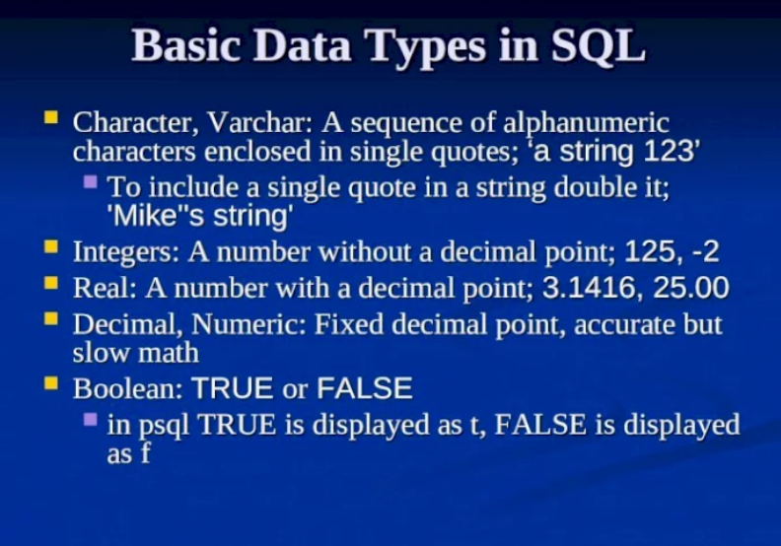

Slide 3
